Slide 1
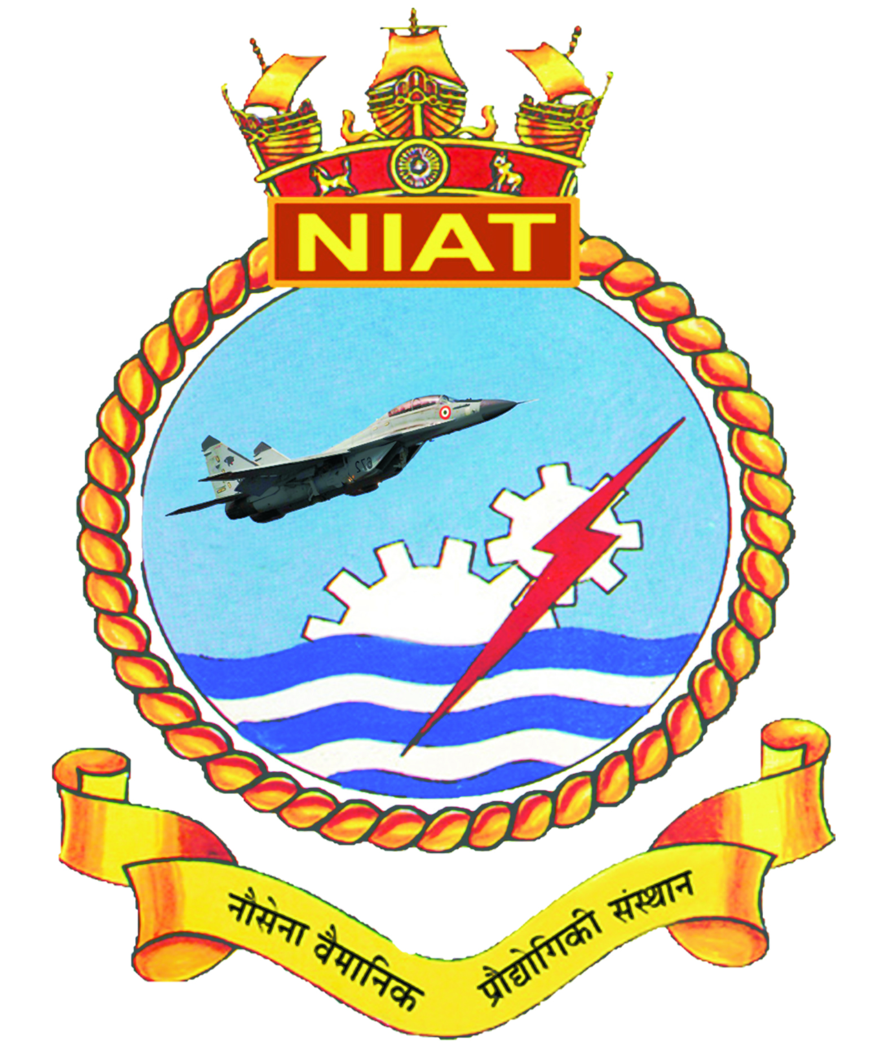
Introduction to aeronautics and classification of aircrafts
Presented by:
Asst. Comdt. Venkatesh Raj
Vetted By:
Commander. Vivek Ratee

Slide 2
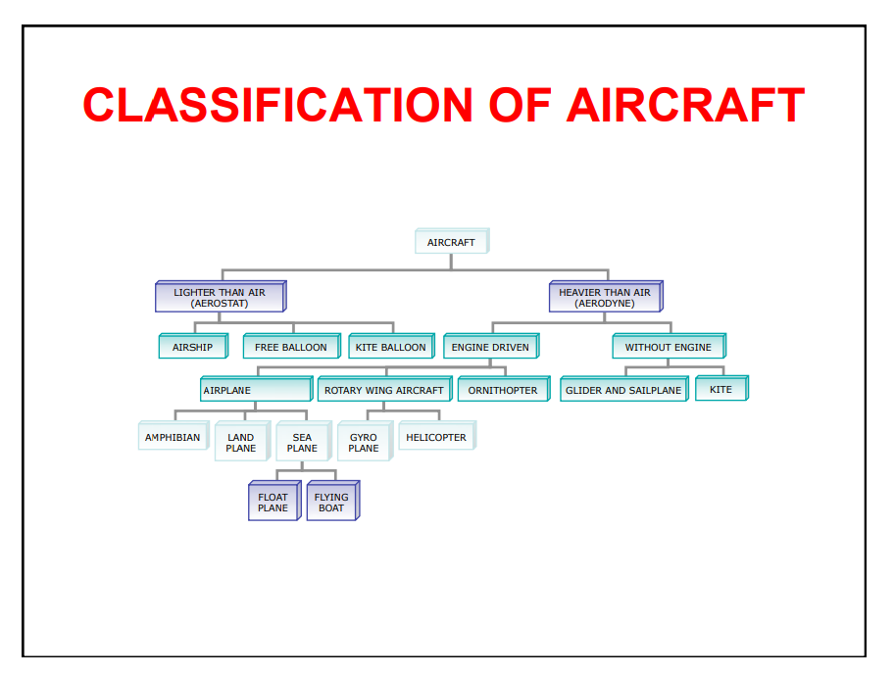

Slide 3
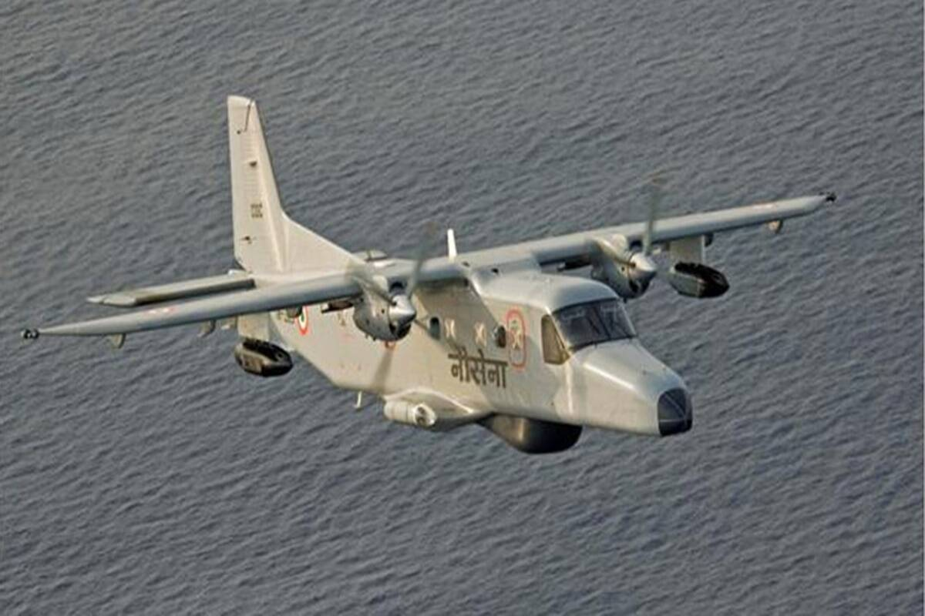
CONFIGURATION OF VARIOUS TYPES OF AIRCRAFTS
Fixed Wing Aircraft
A fixed-wing aircraft is a flying machine, such as an airplane, which is capable of flight using wings that generate lift caused by the aircraft's forward airspeed and the shape of the wings.

Slide 4
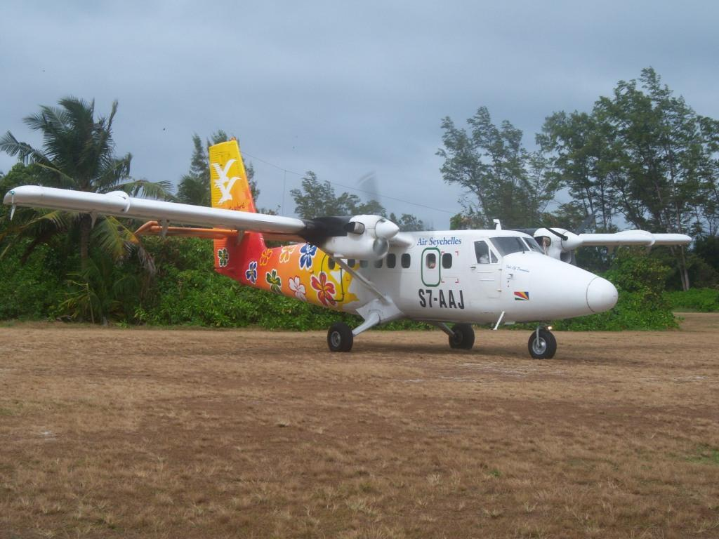
Fixed Wing Aircraft
Light Aircraft : A light aircraft is an aircraft that has a maximum gross take-off weight of 12,500 lb (5,670 kg) or less. Light aircraft are used commercially for passenger and freight transport, sightseeing, photography, and other roles, as well as personal use.

Slide 5
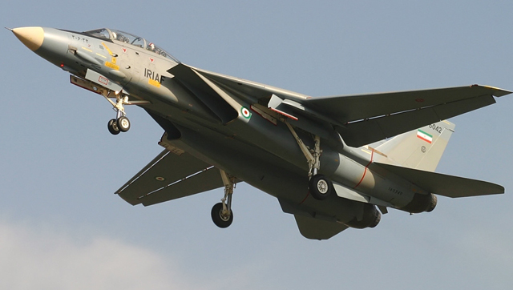
Fixed Wing Aircraft
Fighter Aircraft Often referred to simply as a fighter, is a military fixed-wing aircraft designed primarily for air-to-air combat against other aircraft.

Slide 6
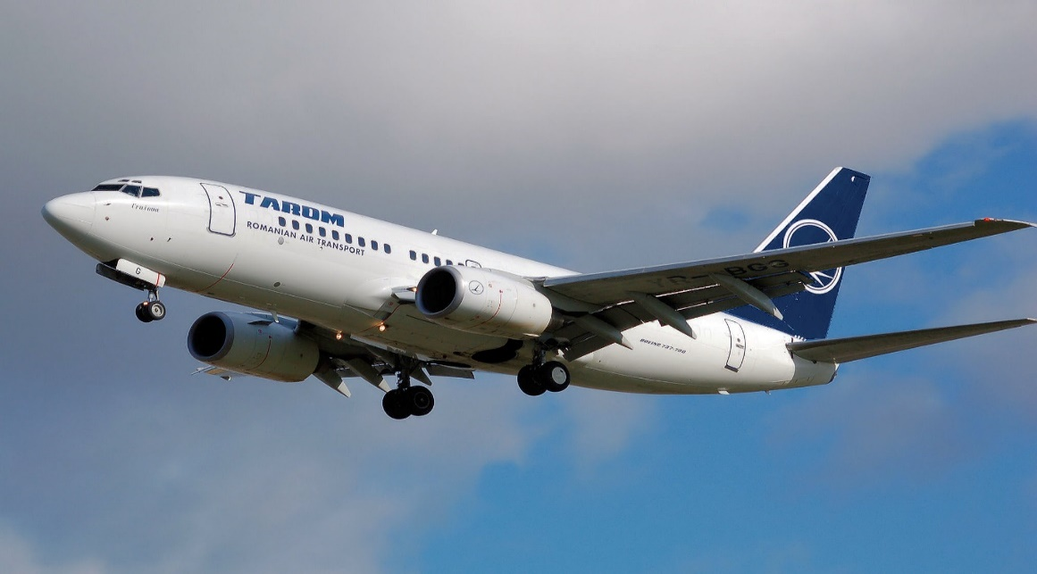
Fixed Wing Aircraft
Passenger Aircraft Such aircraft are most often operated by airlines. Although the definition of an airliner can vary from country to country, an airliner is typically defined as an airplane intended for carrying multiple passengers or cargo in commercial service.

Slide 7
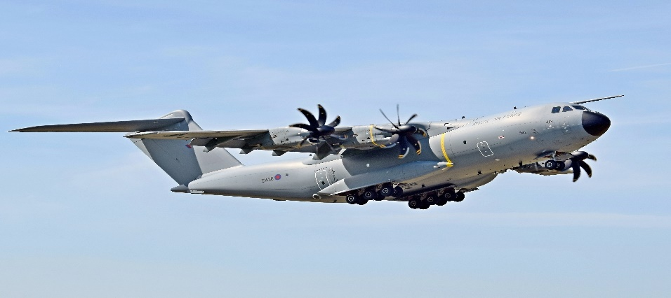
Fixed Wing Aircraft
Cargo Aircraft A cargo aircraft (also known as freight aircraft, freighter, airlifter or cargo jet) is a fixed-wing aircraft that is designed or converted for the carriage of cargo rather than passengers. Such aircraft usually do not incorporate passenger amenities and generally feature one or more large doors for loading cargo. Freighters may be operated by civil passenger or cargo airlines, by private individuals or by the armed forces of individual countries.

Slide 8
Rotary Wing Aircraft
A rotor wing is a lifting rotor or wing which spins to provide aerodynamic lift. In general, a rotor may spin about an axis which is aligned substantially either vertically or side-to-side (spanwise). All three classes have been studied for use as lifting rotors and several variations have been flown on full-size aircraft, although only the vertical-axis rotary wing has become widespread on rotorcraft such as the helicopter.

Slide 9
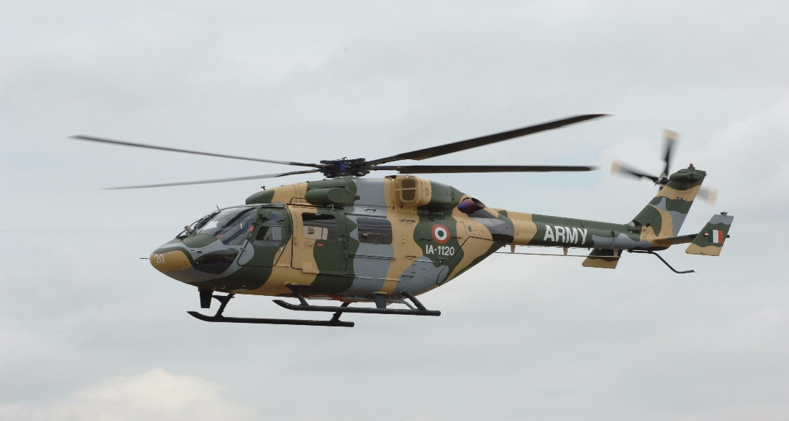
Rotary Wing Aircraft
Light Helicopter The Light Helicopter along with its light derivative is used for civilian and military applications like search and rescue.

Slide 10
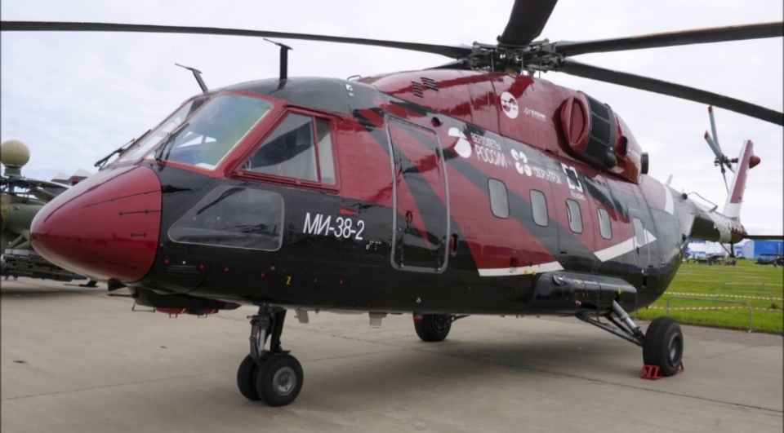
Rotary Wing Aircraft
Passenger Helicopter It belongs to the super medium class of helicopters, and addresses several missions, including:
Offshore crew change
Law enforcement
Search and rescue
Helicopter emergency medical services (HEMS)
Private and business aviation

Slide 11
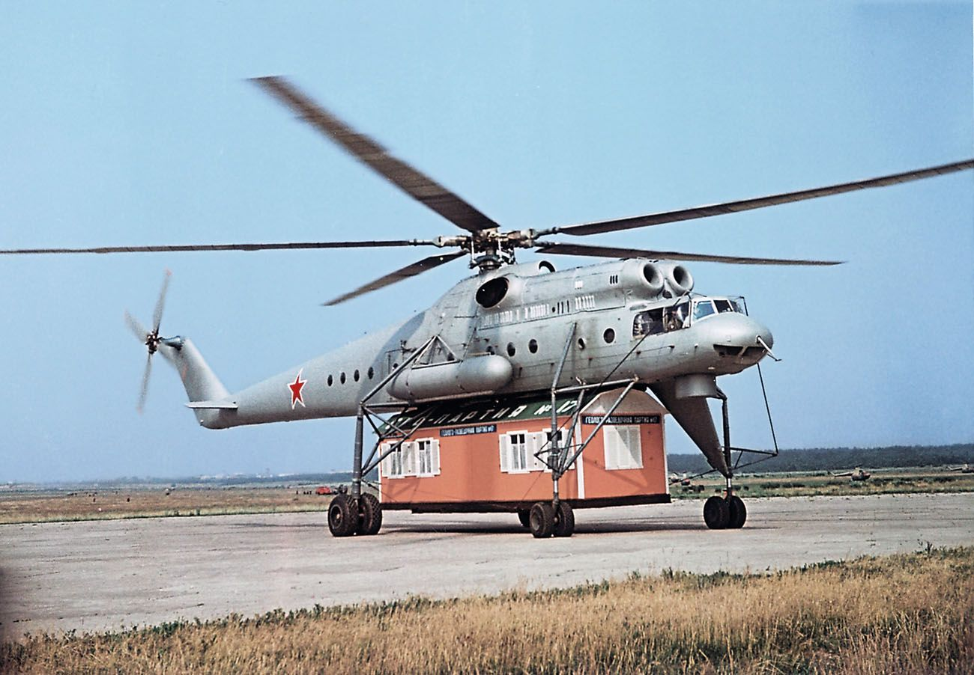
Rotary Wing Aircraft
Cargo Helicopter Cargo is carried either internally, or externally by slung load where the load is suspended from an attachment point underneath the aircraft. Personnel are primarily loaded and unloaded while the helicopter is on the ground.

Slide 12

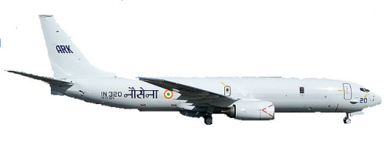
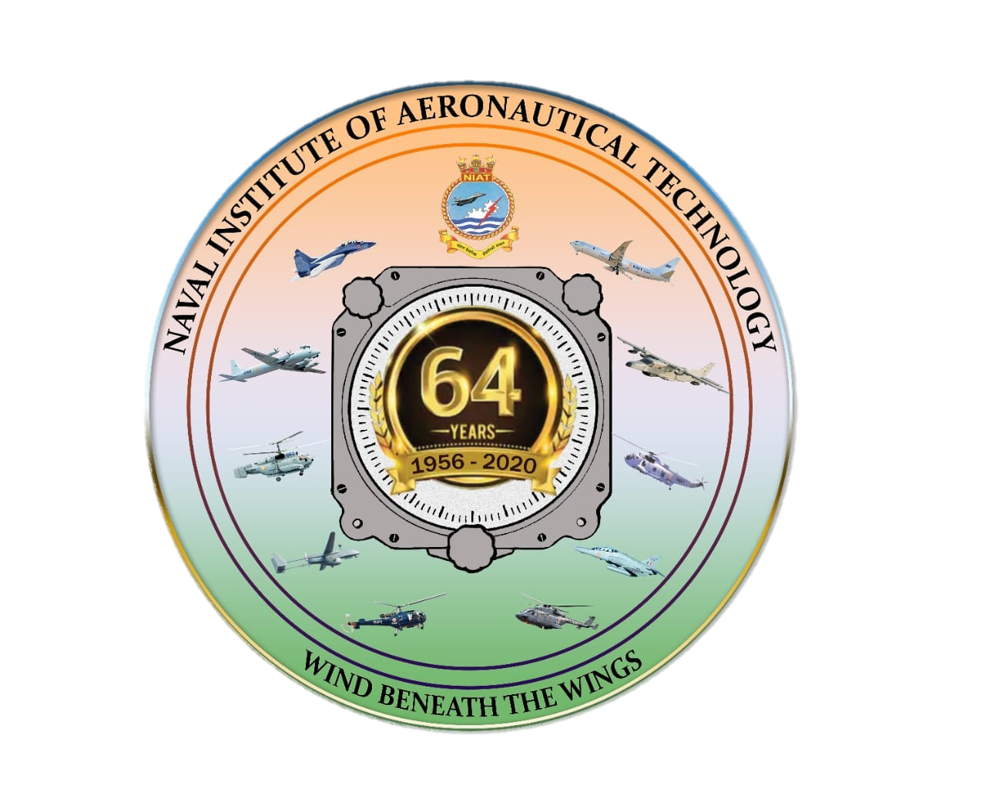
Thank You

